Slide 1


Visible Light Communication
Denny Darlis
Presentation on Optical Fiber Seminar by IEEE Student Branch – Telkom University, Bandung
April 25th , 2015

Slide 2
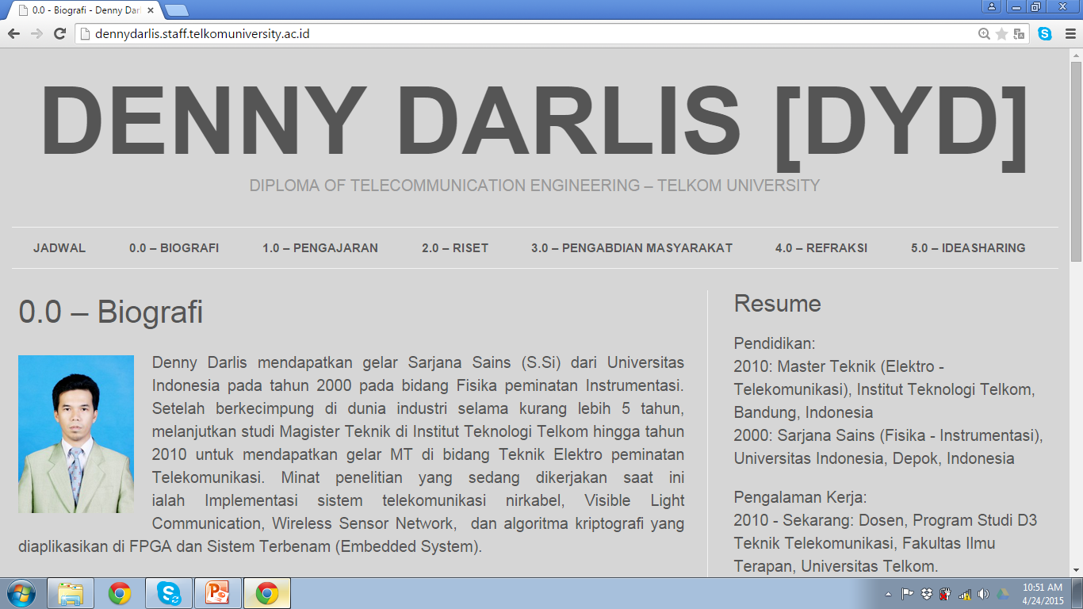

Slide 3

Sumber : http://shadowness.com/onfiksi/are-you-ready-to-rock-2

Slide 4
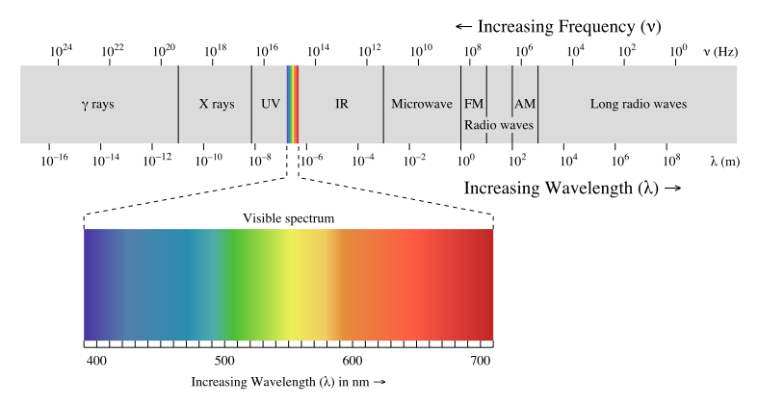
Visible Light Communication
adalah sistem komunikasi nirkabel*) yang membawa informasi dengan cara memodulasi cahaya tampak yang aman bagi mata manusia
*) bagian dari Unguided-Optical Wireless Communication

Slide 5
Cahaya Tampak = Gelombang EM dengan spektrum ∼400 – 800 THz (750-375 nm)*,
*)± 10000 spektrum frekuensi dapat digunakan
Karakteristik umum :
  Visibility : secara estetika ramah
  Aman : apa yang dilihat adalah apa yang dikirim
  Kesehatan : aman bagi tubuh manusia (terutama mata)
  Tidak berlisensi : tidak ada regulasi terkait frekuensi optik
  Digunakan di daerah umum hingga terlarang (pesawat, rumah sakit, pesawat luar angkasa, pabrik petrokimia dll)

Slide 6
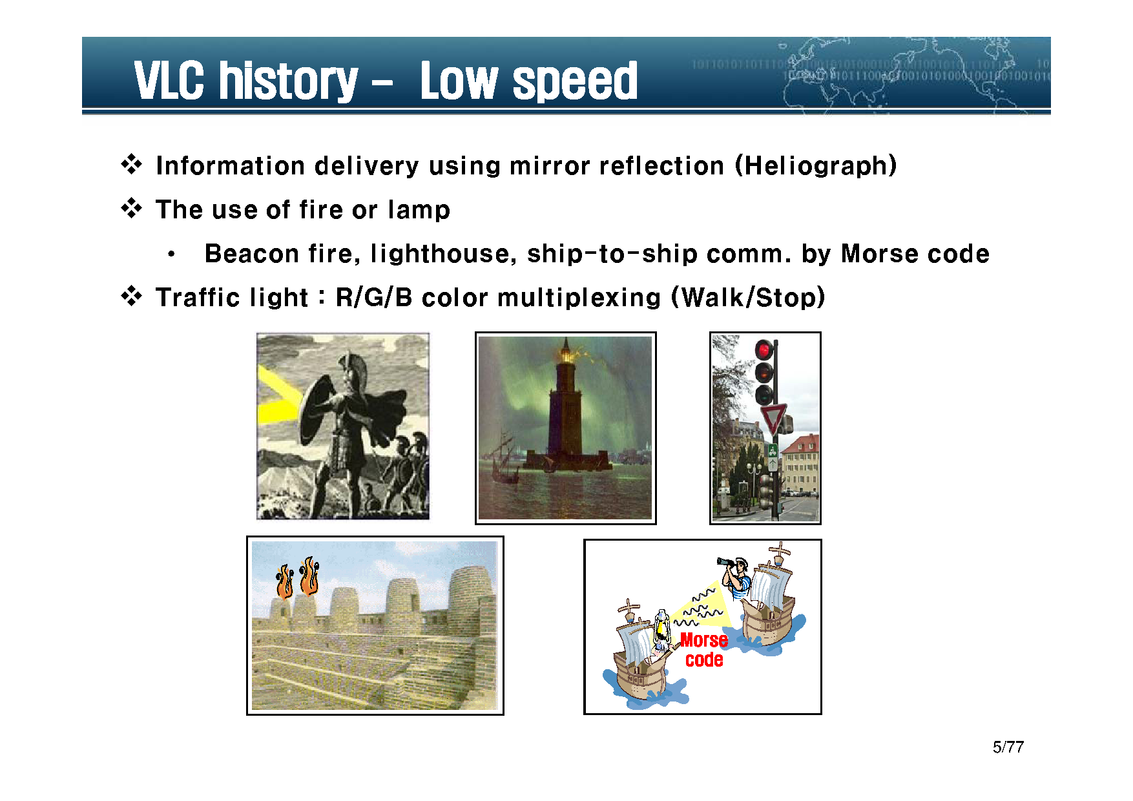

Slide 7
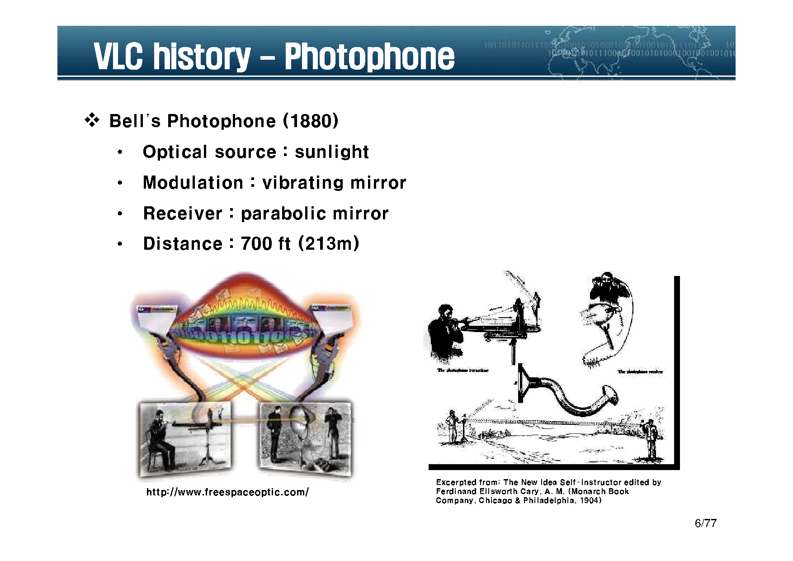

Slide 8
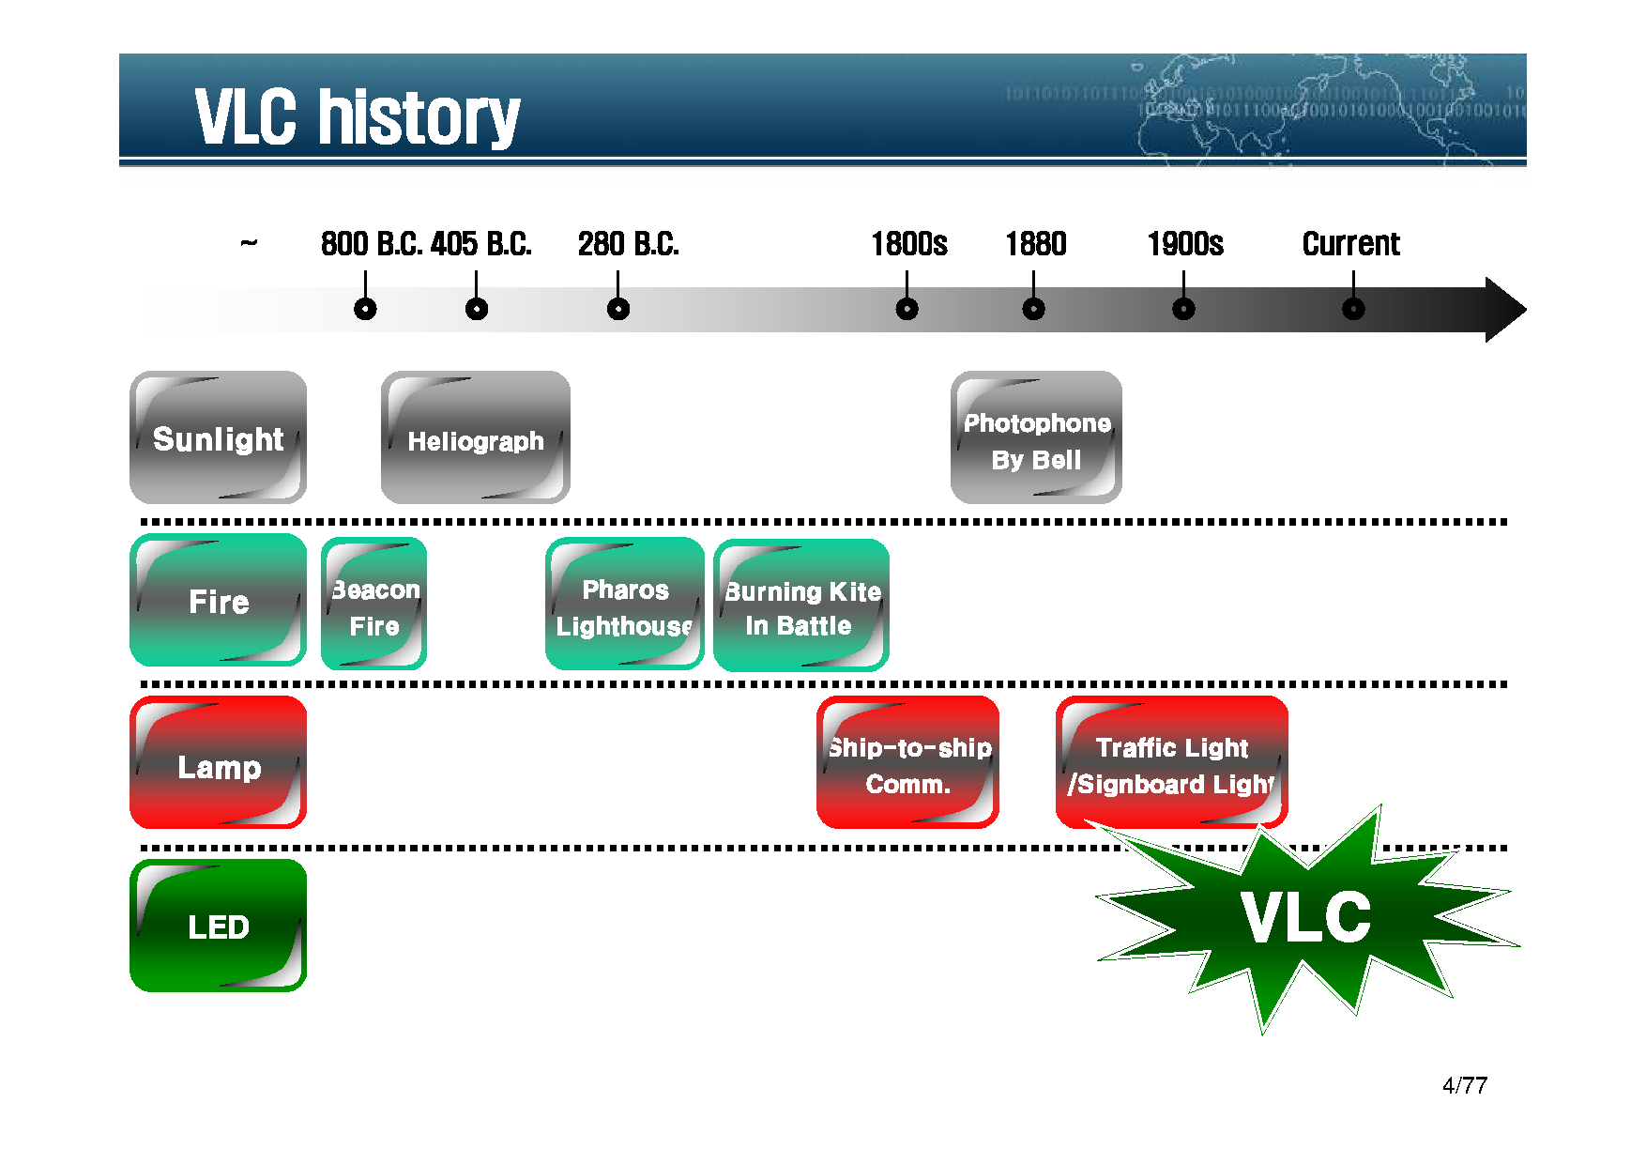

Slide 9
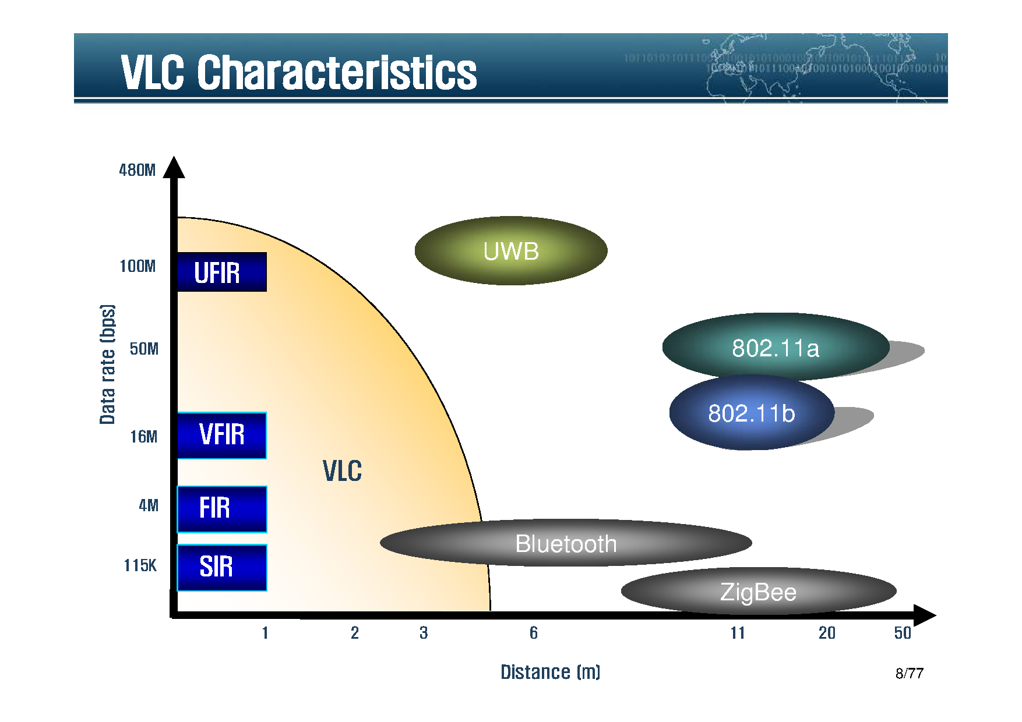

Slide 10
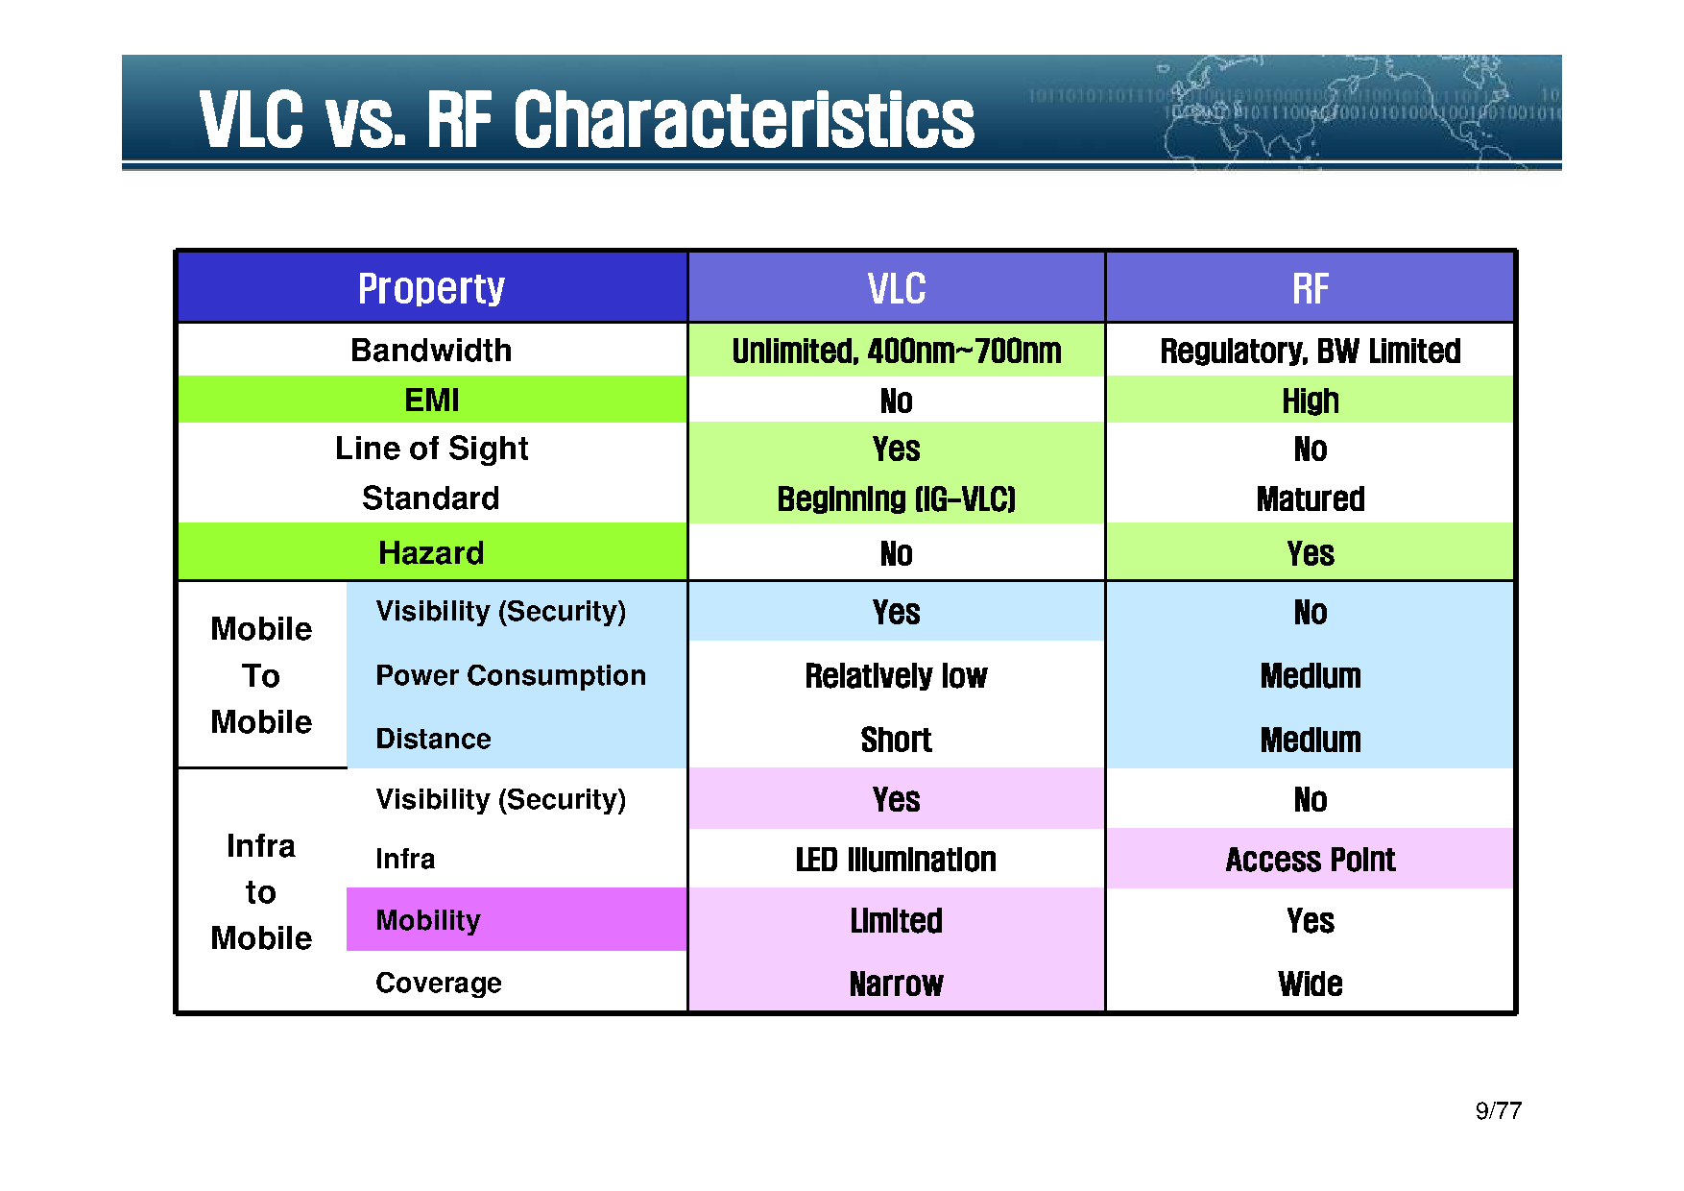

Slide 11
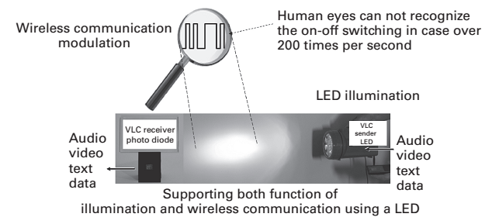
Prinsip Kerja VLC
Memodulasi informasi ke intensitas LED nyala-mati pada kecepatan yang melebihi respon mata manusia (≥ 200 Hz)
Memastikan nyala lampu LED sesuai dengan standar lampu penerangan atau kurang
Menerima informasi menggunakan Photodioda dengan kecepatan yang sama dengan pengiriman informasi
PHY
MAC

Slide 12
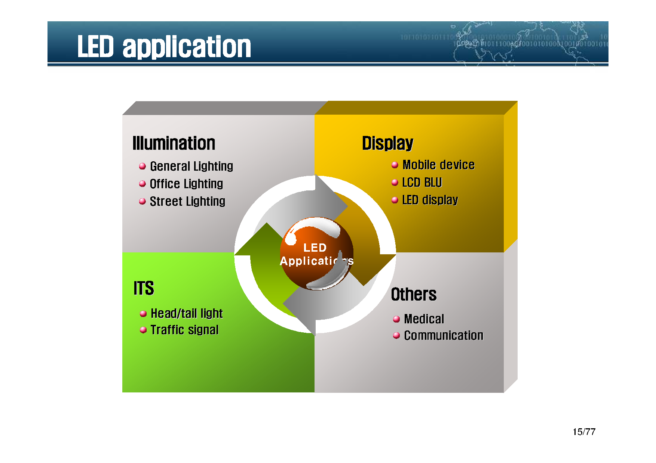

Slide 13
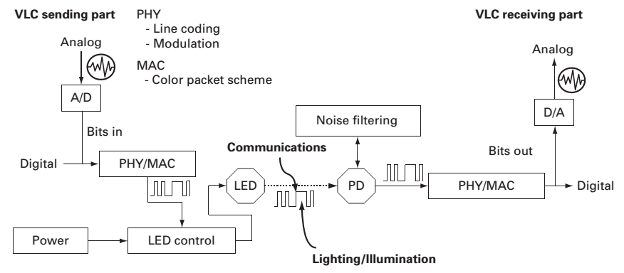
Arsitektur VLC PHY

Slide 14
IEEE 802.15.7
Short-range wireless optical communication using visible light dipublikasikan pada 6 September 2011
IEEE 802.15.7 Visible Light Communication Task Group telah mengembangkan standar VLC untuk PHY dan MAC pada tahun 2009; Study Group pada tahun 2008, dan Interest Group pada tahun 2007
IEEE 802.15.7 VLC memiliki tiga jenis PHY yang bergantung pada penerapannya, yaitu PHY I,PHY II, and PHY III.

Slide 15
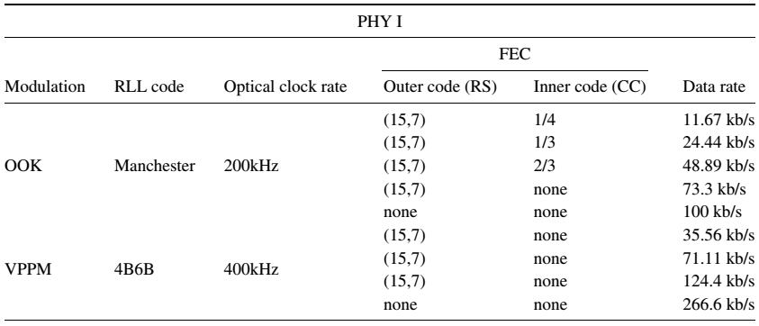
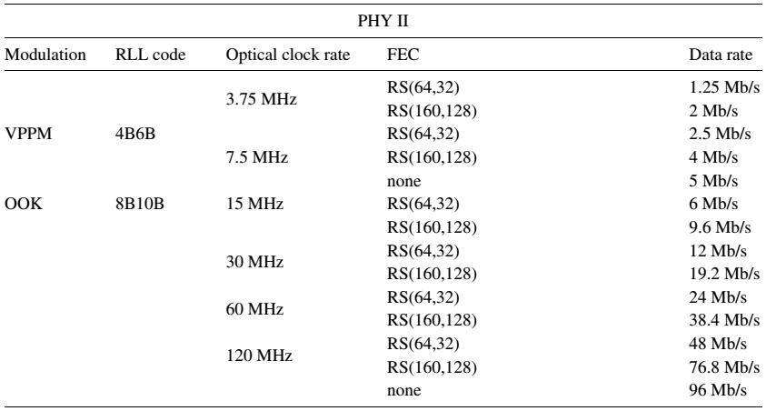
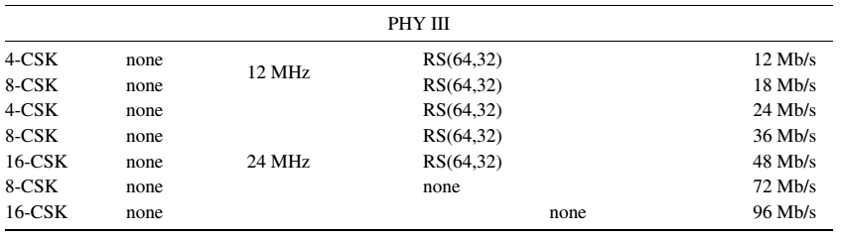
Notes:
RLL = Run Length Limited
RS = Reed Solomon
CC = Convolutional Code
OOK = On-Off Keying
VPPM = Variable Pulse Position Modulation
CSK = Color Shift Keying
4B6B = 4Bit-to-6Bit Line Coding for non flickering
8B10B = 8Bit-to-10Bit Line Coding

Slide 16
“LiFi”
high-speed, bidirectional, networked and mobile wireless communications using light.
High speed
  Data rates of at least 10 Mbps per access point
Bidirectional
  Light spectrum (190 nm – 10,000 nm wavelength) used for
  uplink and downlink
Networked
  Facilitate network connectivity and management
Mobile
  Support roaming users and multiple users per access point (hand-over and multiple access)

Slide 17
LiFi: High Level Concepts
High speed
  Efficient use of optical bandwidth
Bidirectional
  Support full uplink and downlink communications without additional RF resources
Networked & Mobile
  User expectations of wireless technology
Secure & Safe
  Privacy, cybersecurity and EMI concerns

Slide 18
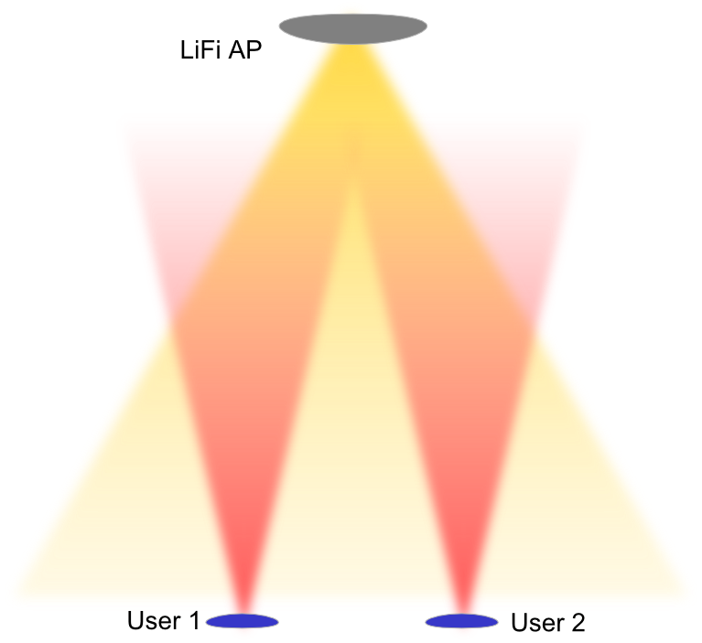
LiFi: bidirectional and multiple access support
Bidirectional
  LiFi operates entirely in the light spectrum and can help alleviate the spectrum crunch
  Users request access to the AP which may be connected to the network
  Users may see multiple APs
  APs may see multiple users
  The inherent directionality of light beams is used to define strict coverage regions

Slide 19

LiFi: mobility and hand-over support
Networked & Mobile
  Users can move from one light source to another and retain their session
  Users do not need to be aligned with the light source and may connect to the strongest light source
  The signal may be detected from reflections as well as direct line of sight

Slide 20
LiFi: Complementary to existing RF

Slide 21
LiFi: Competitive Advantages
Security
  If no photons escape, there is no external network intrusion
Localization
  Strictly defined illumination area, sharp SINR cut-off, enables geo-fencing and asset tracking
Safety
  No RF radiation alleviating health and EMI concerns
Data Density
  Smaller Li-Fi cells allow significantly greater spatial reuse of bandwidth

Slide 22
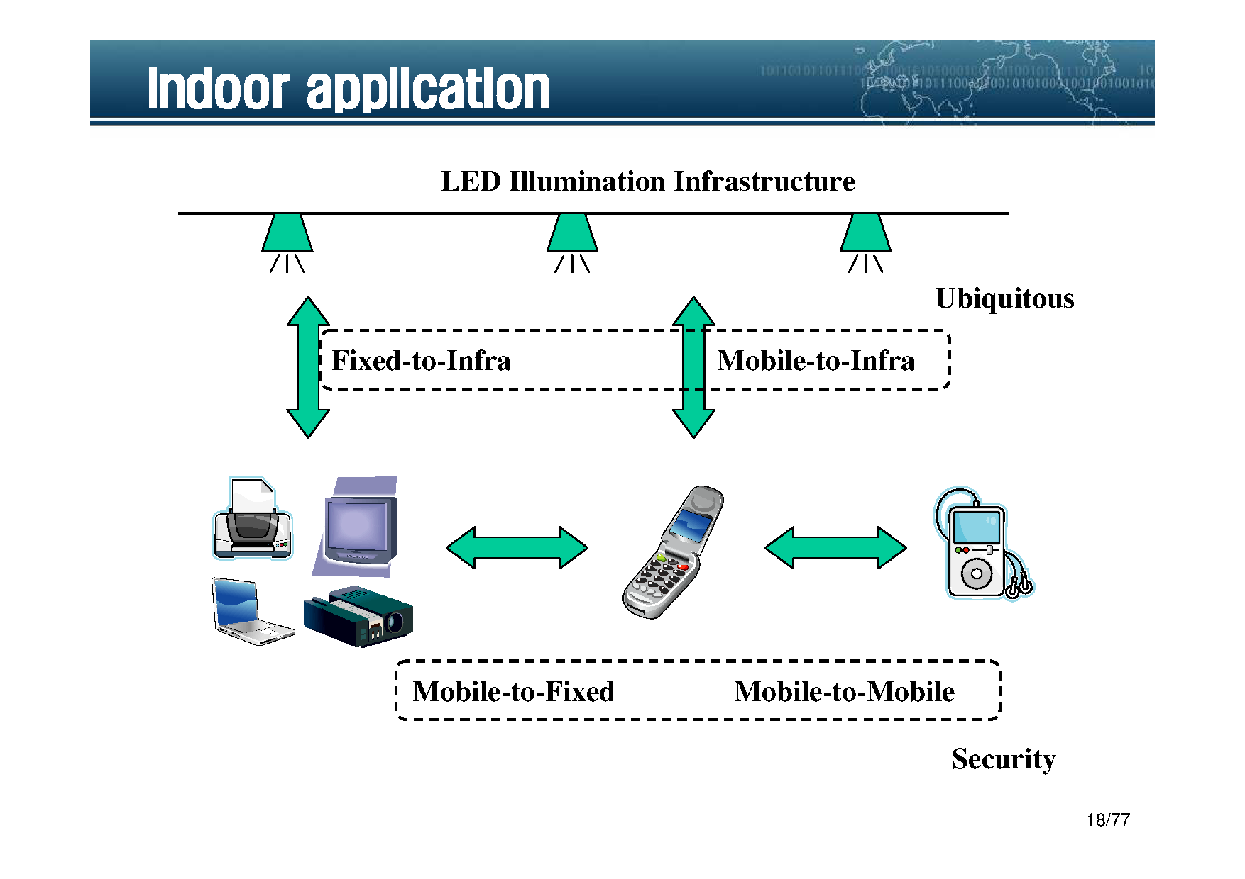

Slide 23
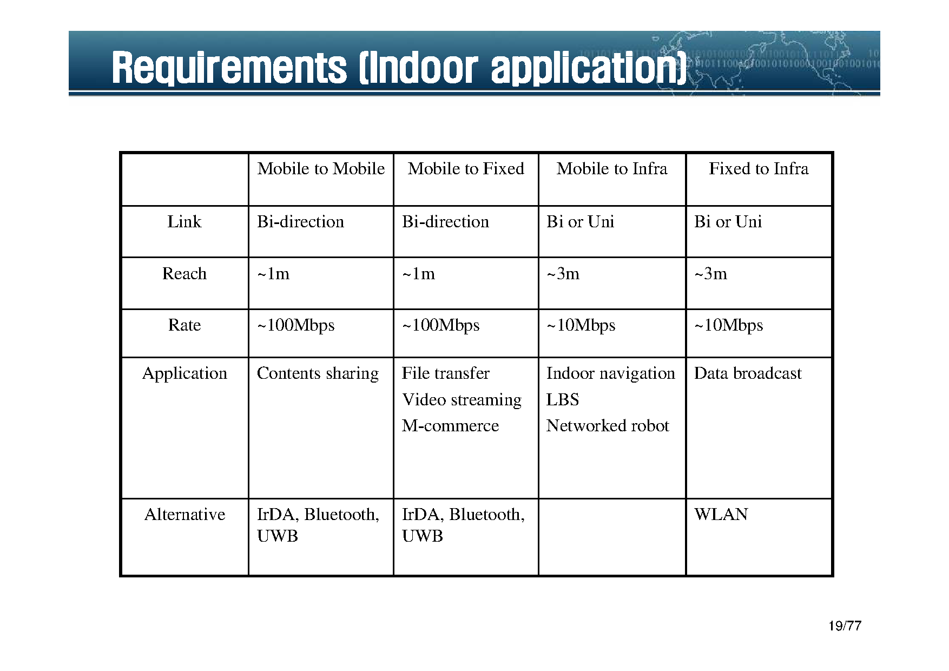

Slide 24
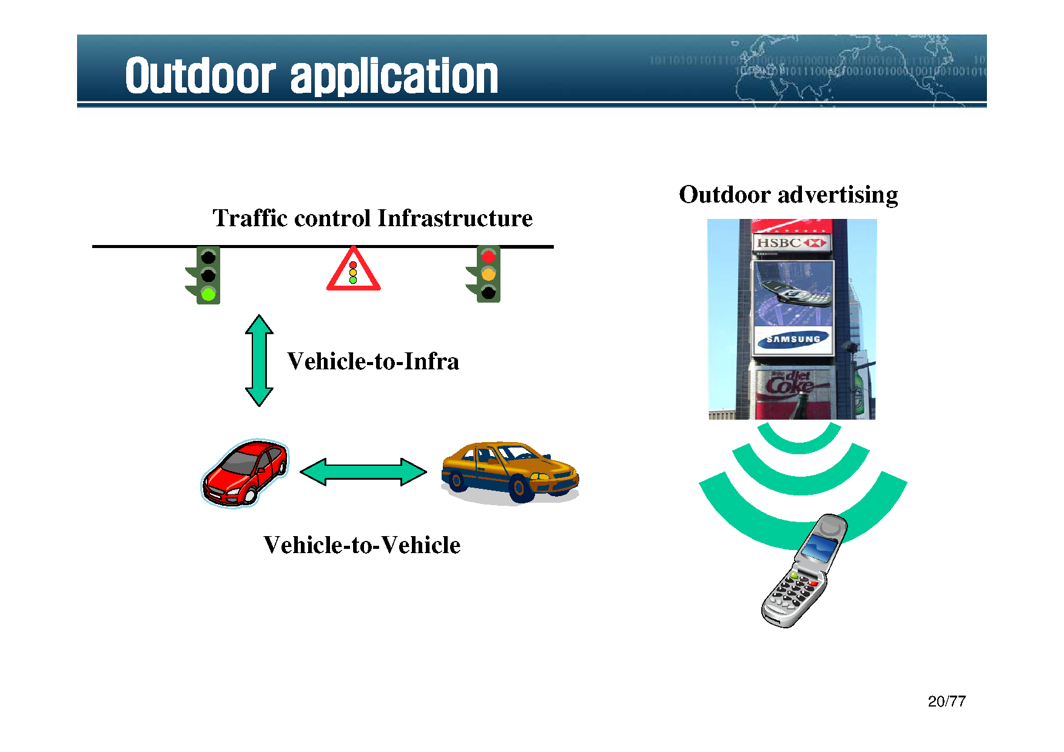

Slide 25
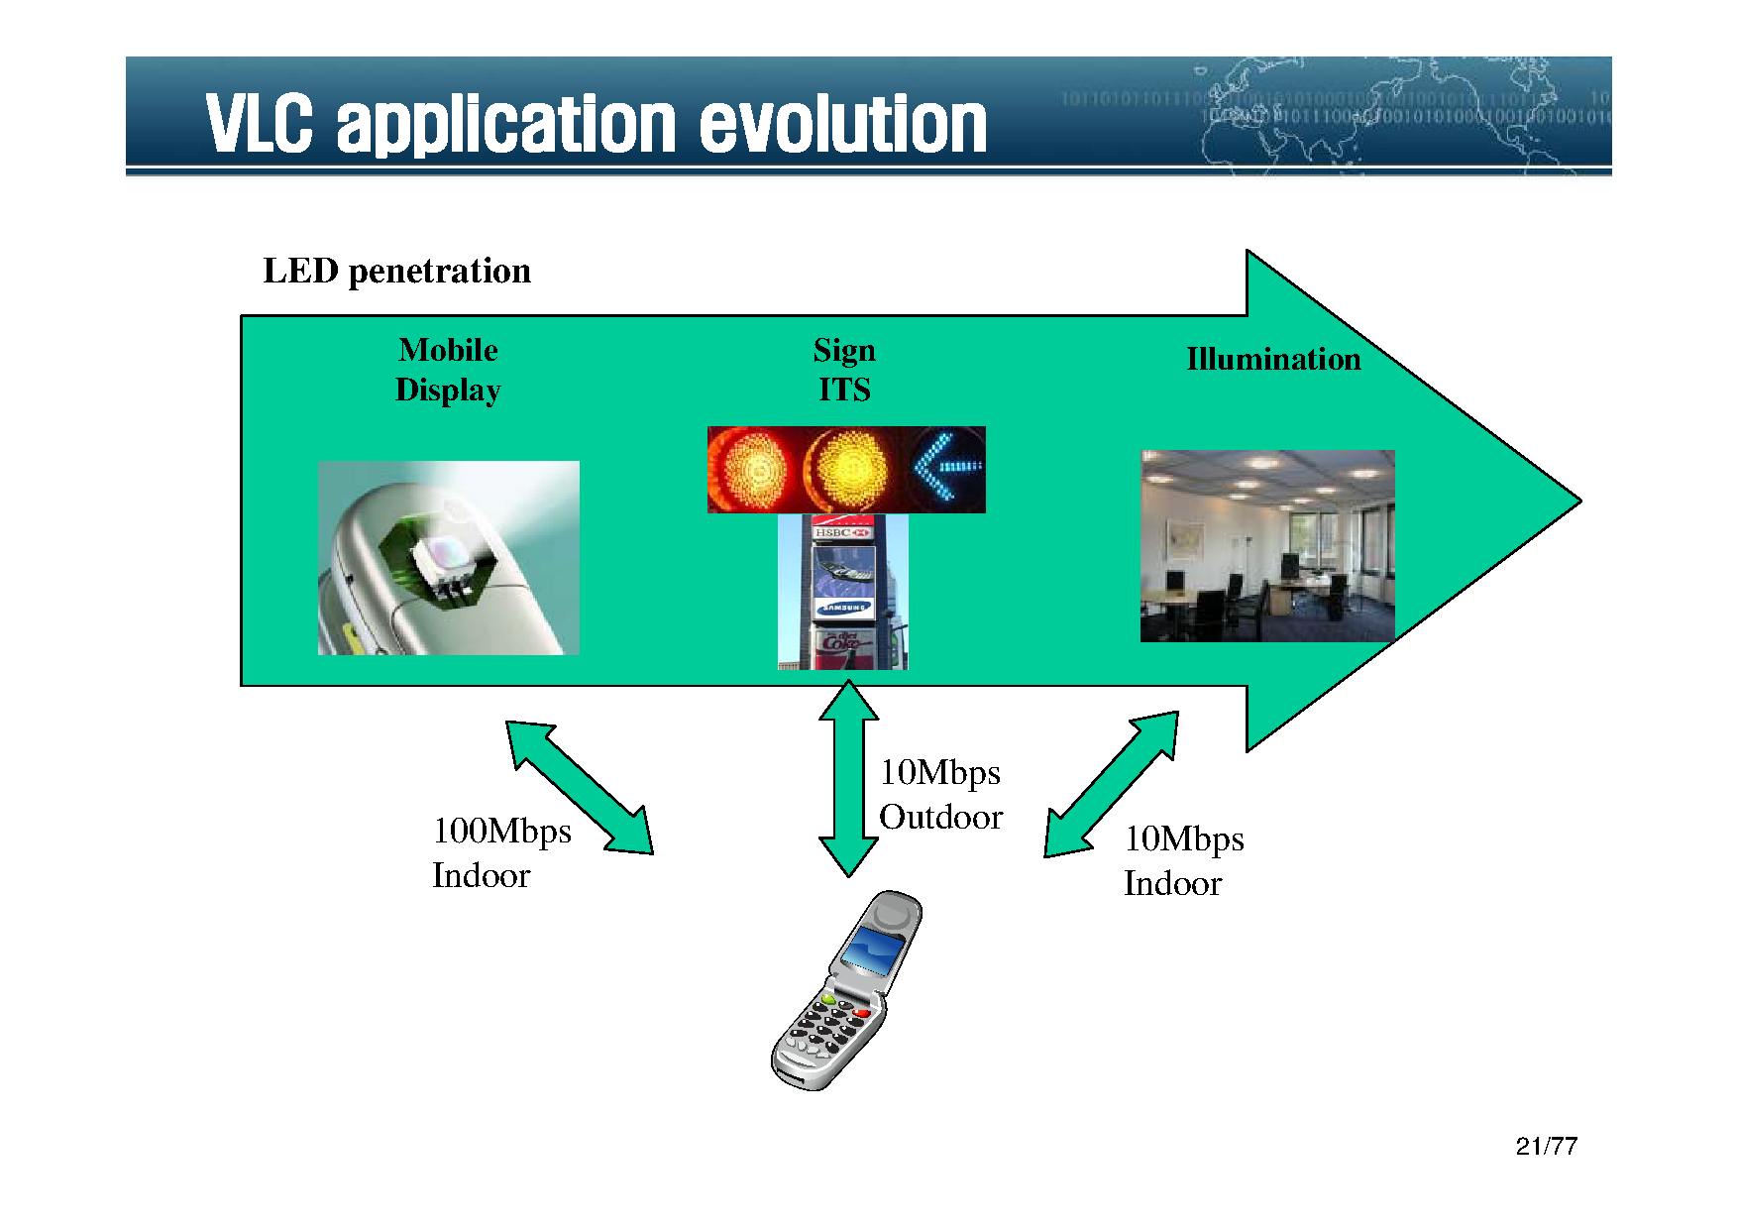

Slide 26
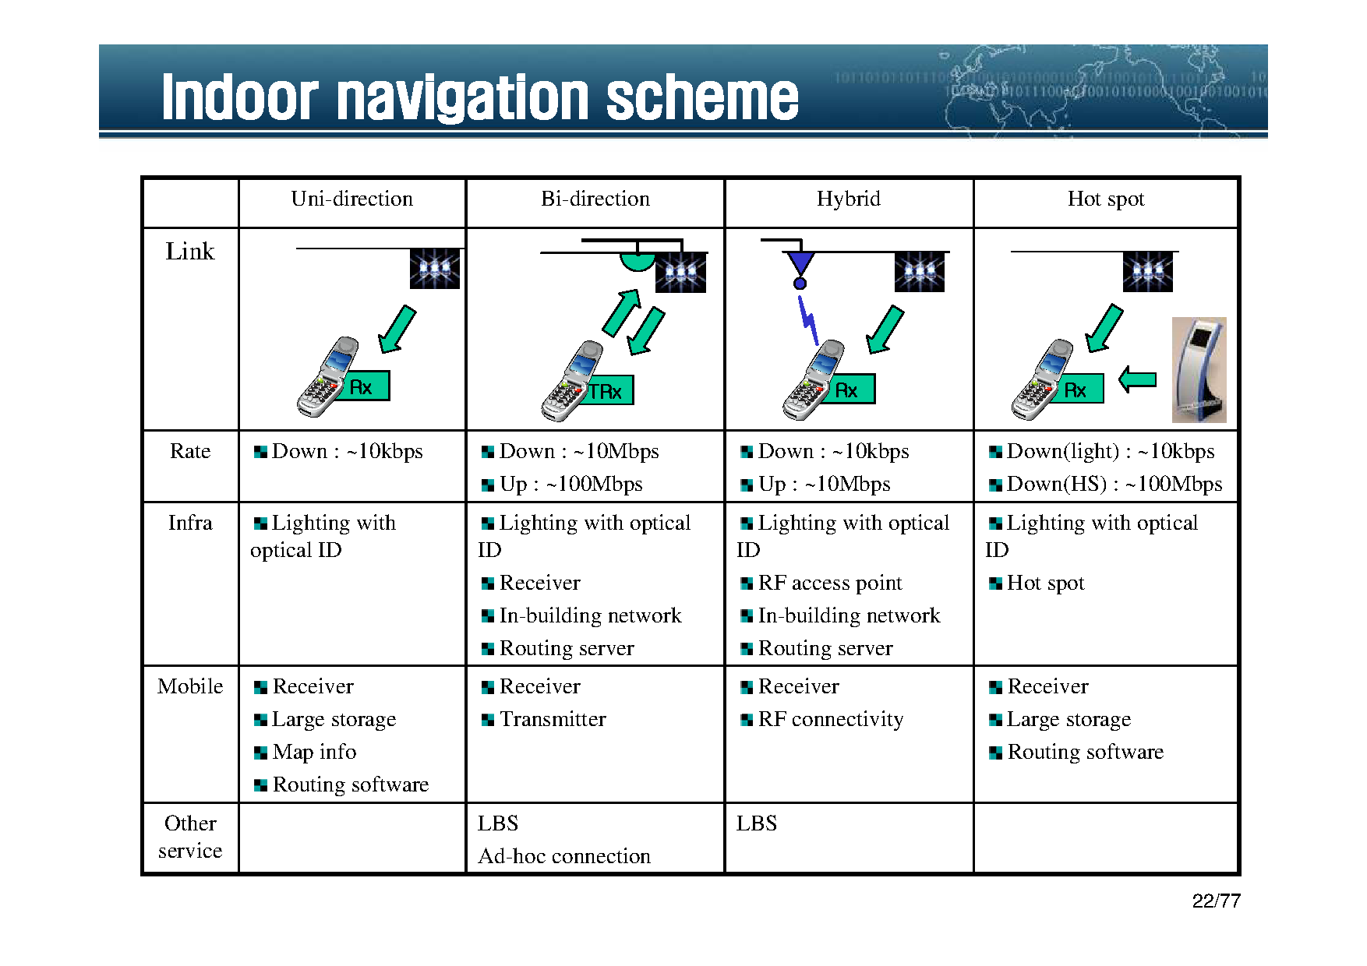

Slide 27
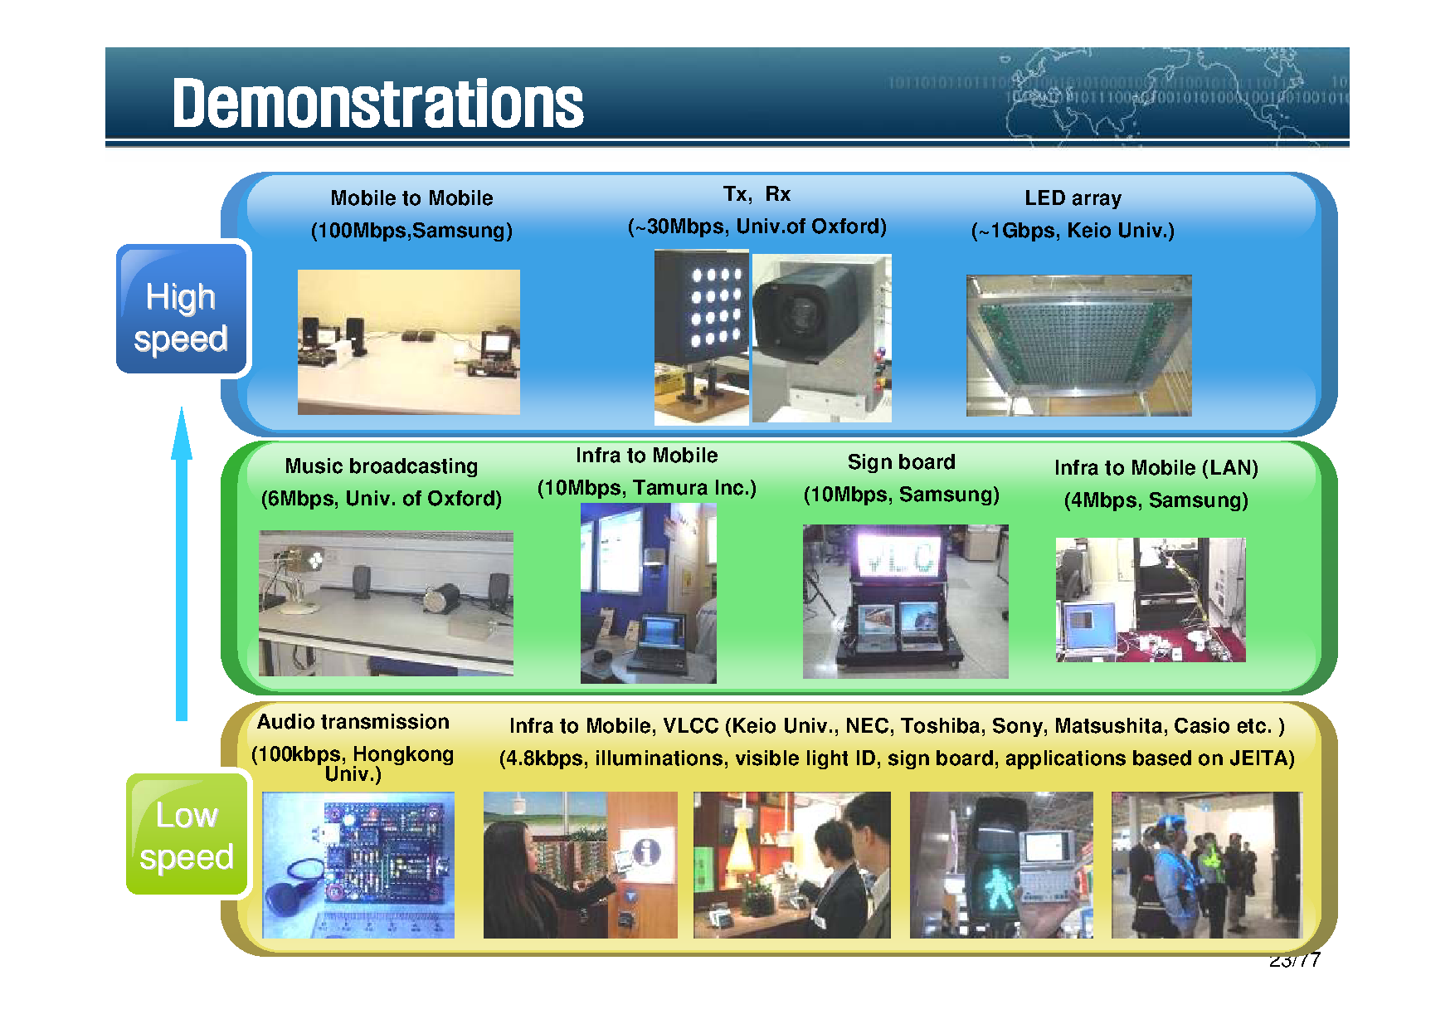

Slide 28
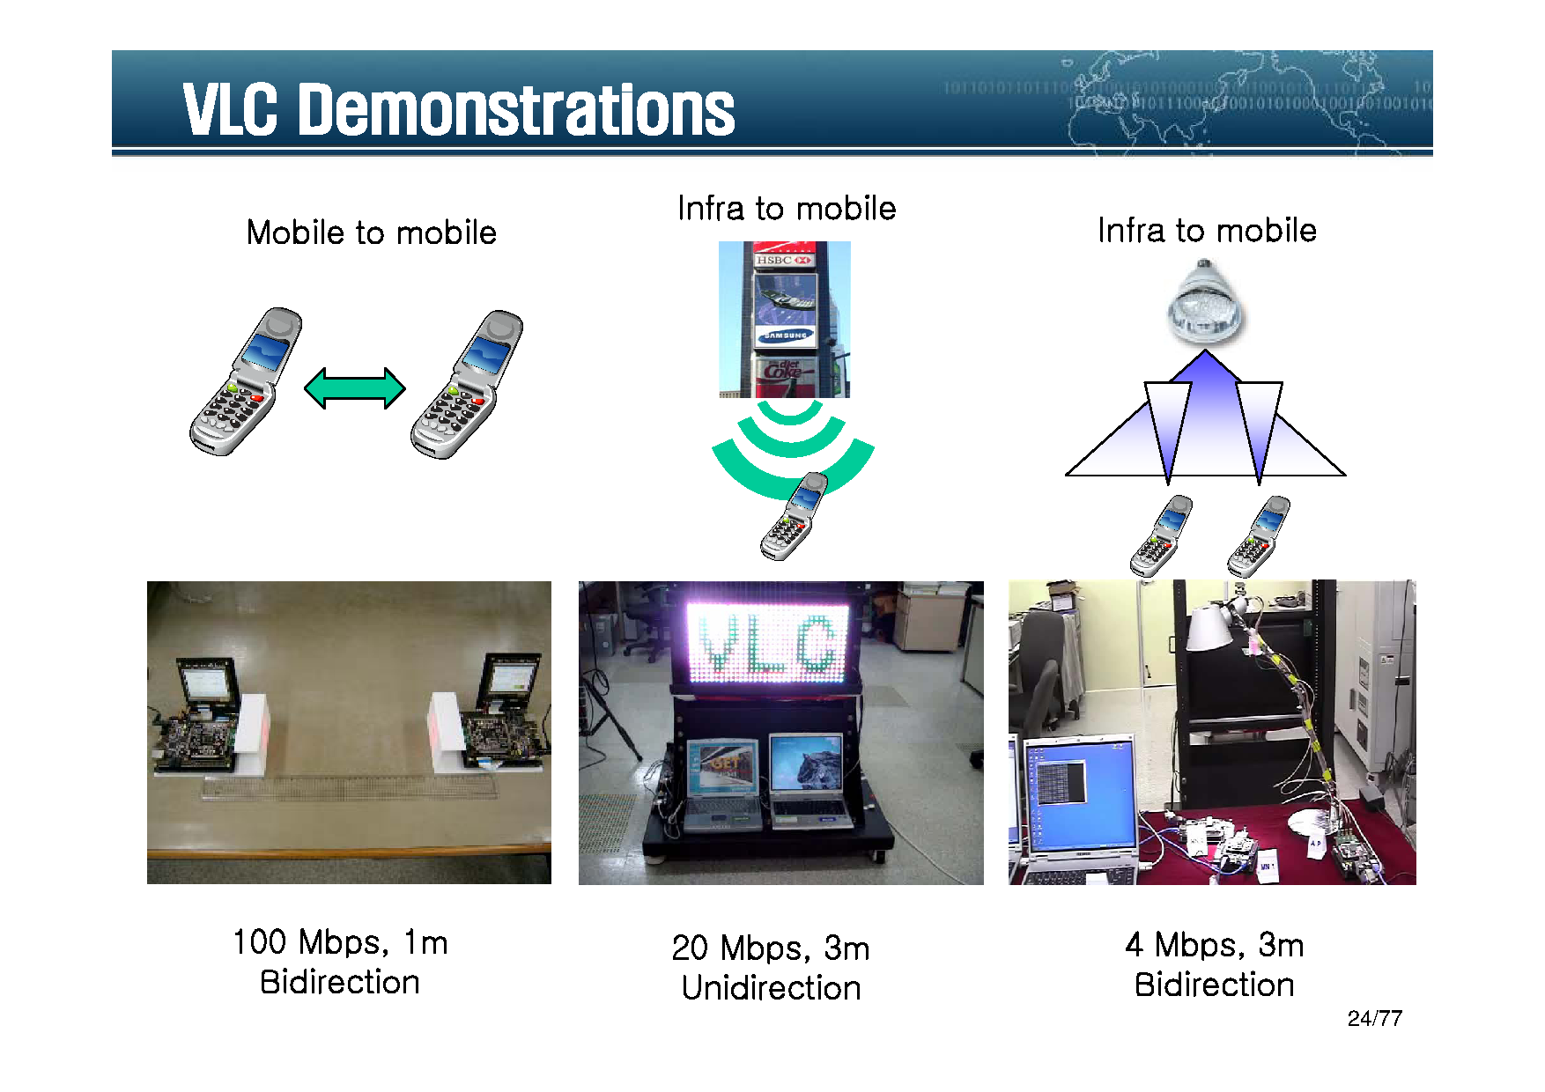

Slide 29
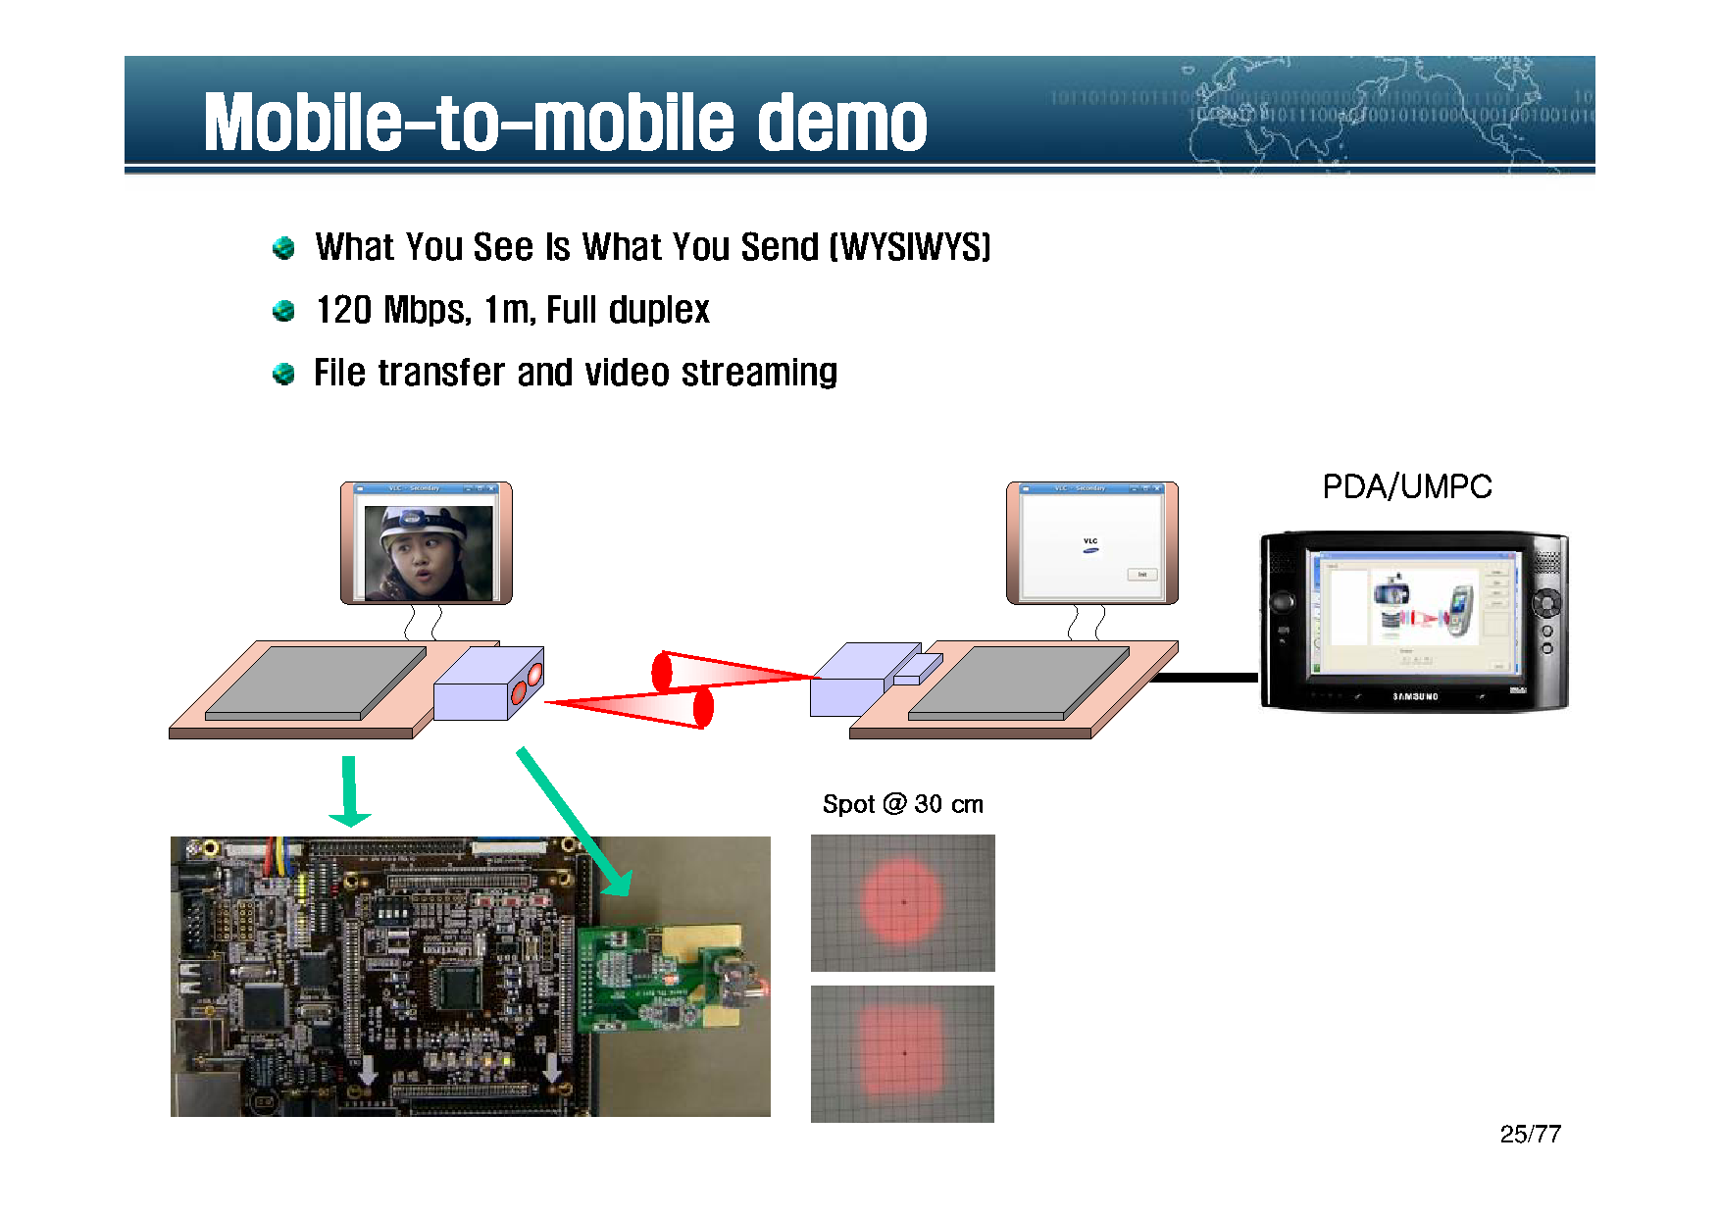

Slide 30
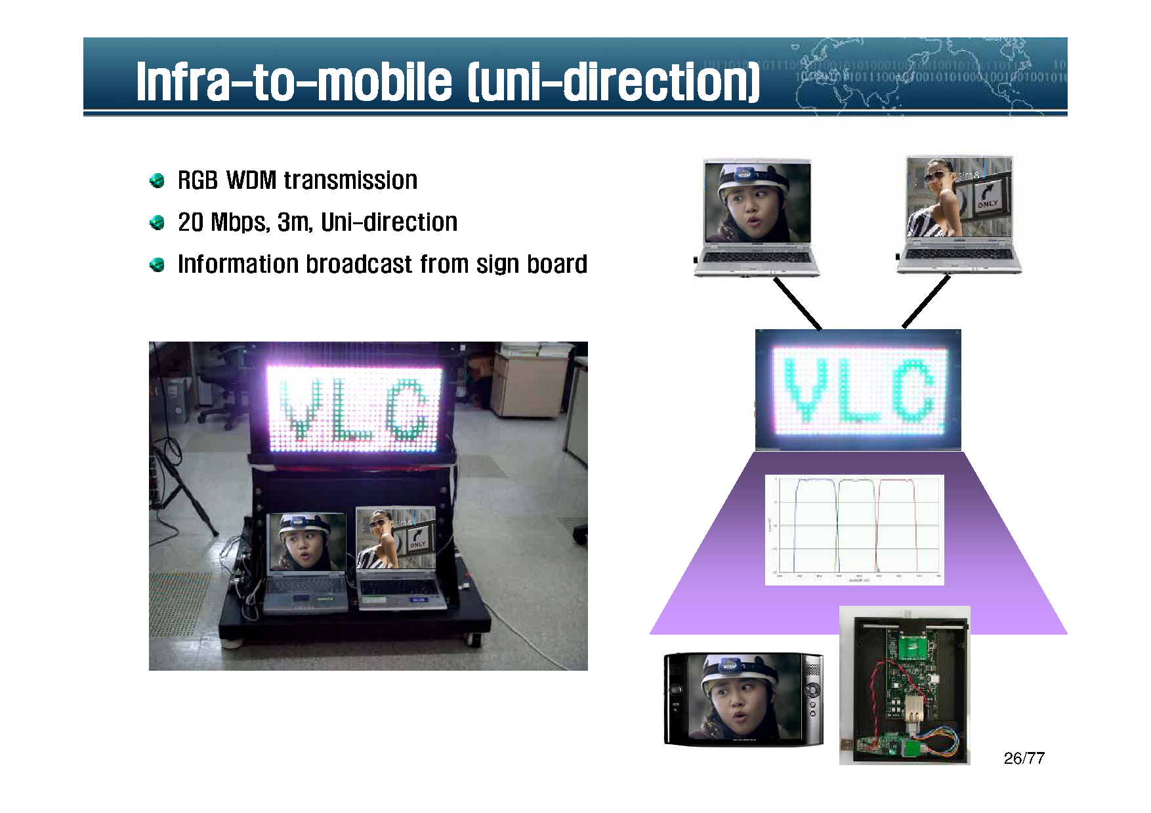

Slide 31
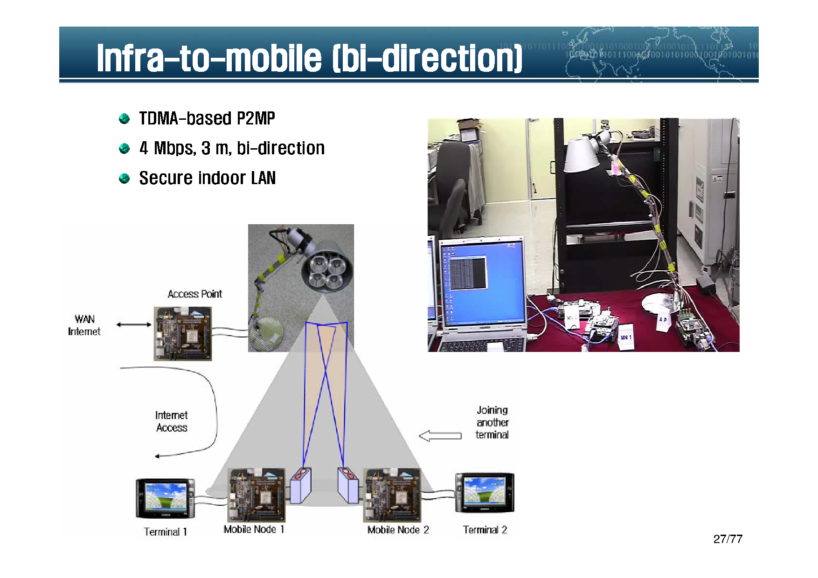

Slide 32
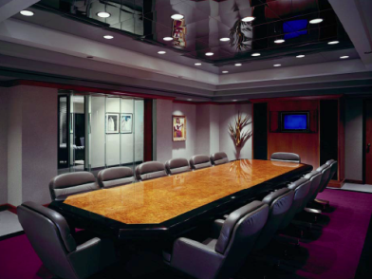
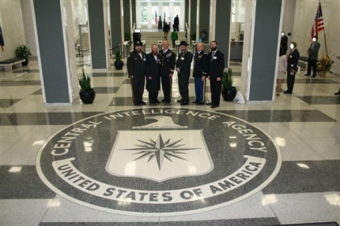
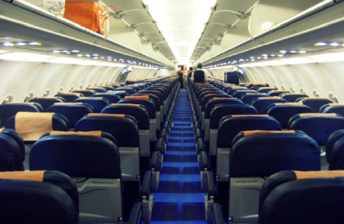

LiFi: use-cases
Security Conference rooms
Hangers and storage depos
Airplanes and Airports
EMI sensitive environments
  Hospitals, Petrochemical plants,
  Nuclear facilities, etc.

Slide 33
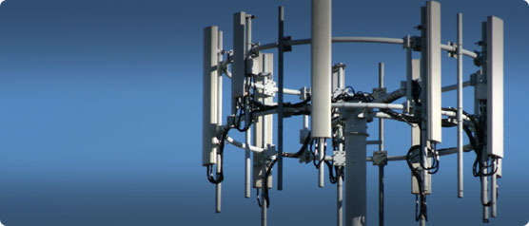
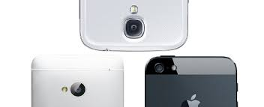
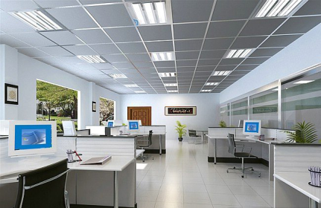
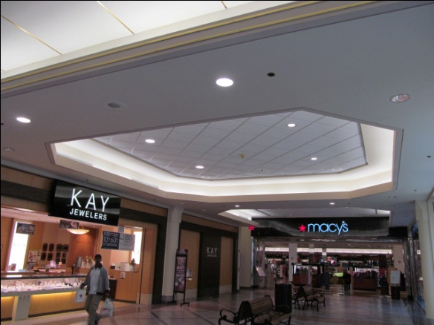
LiFi: use-cases
Spectrum relief
  Every-day mobile communications
Open plan offices
Hotels
Research Institutions

Slide 34
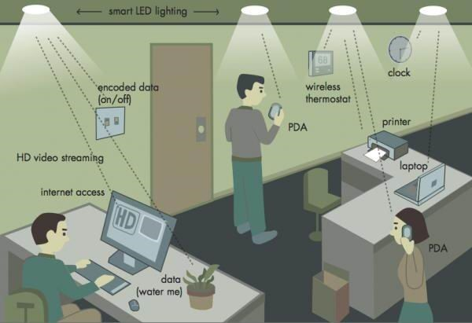
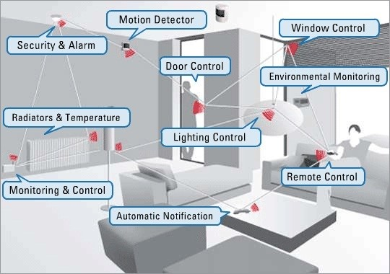
LiFi: use-cases
Smart Home
Smart Office

Slide 35
Future Challenge
Automatic Focus and Optic Antenna Design for VLC Systems
Channel Modeling and Characterization of VLC Systems
Coding for VLC systems
Computing with Light
Efficient Signal Processing Algorithms for VLC systems
Indoor Communication
Information Display and Communications
Integration of VLC with other Wireless Technologies
Inter-vehicle Communication
Intra-vehicle Communication
Vehicle to Infrastructure Communication
Visual Signaling and Communication
Visible Light Communication Networks
Localization using Visible Lighting
Interference Mitigation, Multiuser Access, and Duplexing Techniques
MIMO Technologies in VLC Systems
Mobility Management
Network Protocol and Network Architecture for VLC
New Modulation Methods for VLC Systems
Novel Designs for VLC Systems
Positioning and Communications
Security Issues in VLC
Specific Integrated Chip for VLC Systems
System Designs and Architectures Coupling VLC Capabilities with RF
Practical Applications with VLC System
Standardization Activities Related to VLC
Challenges in VLC commercialization Activities

Slide 36
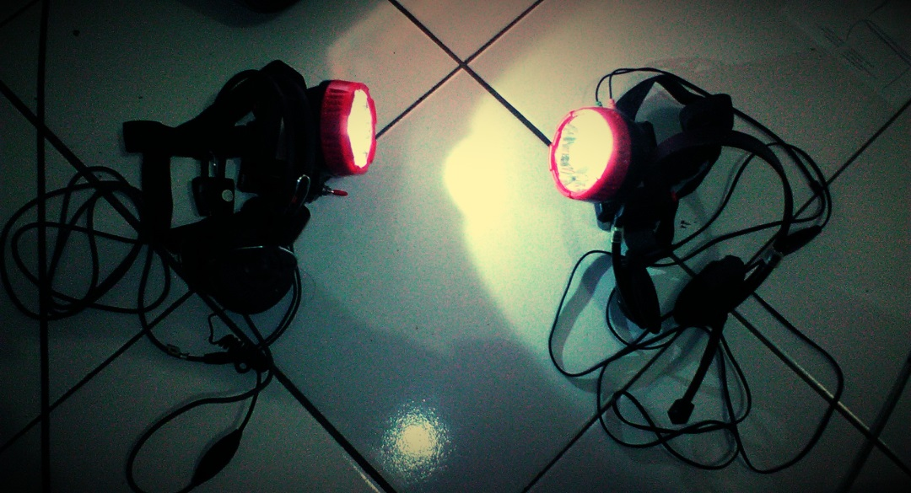
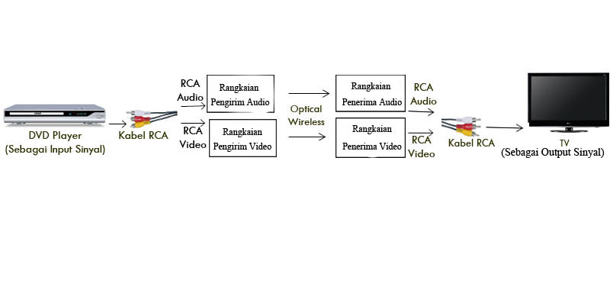
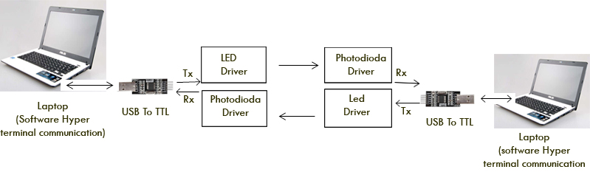
Proof of Concept

Slide 37
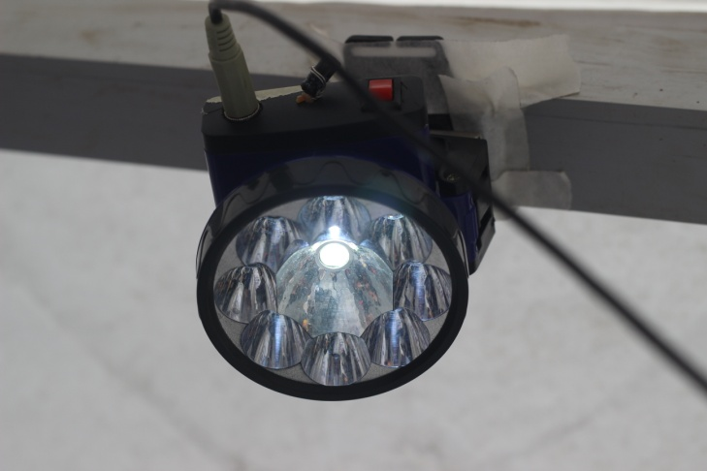
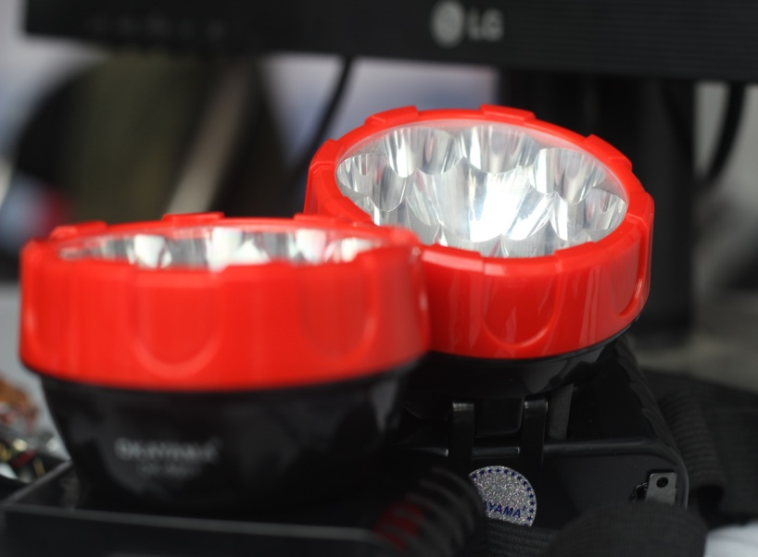
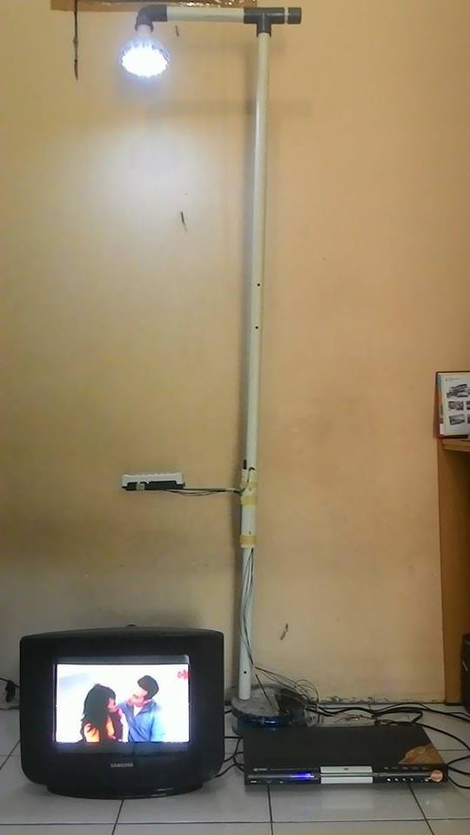
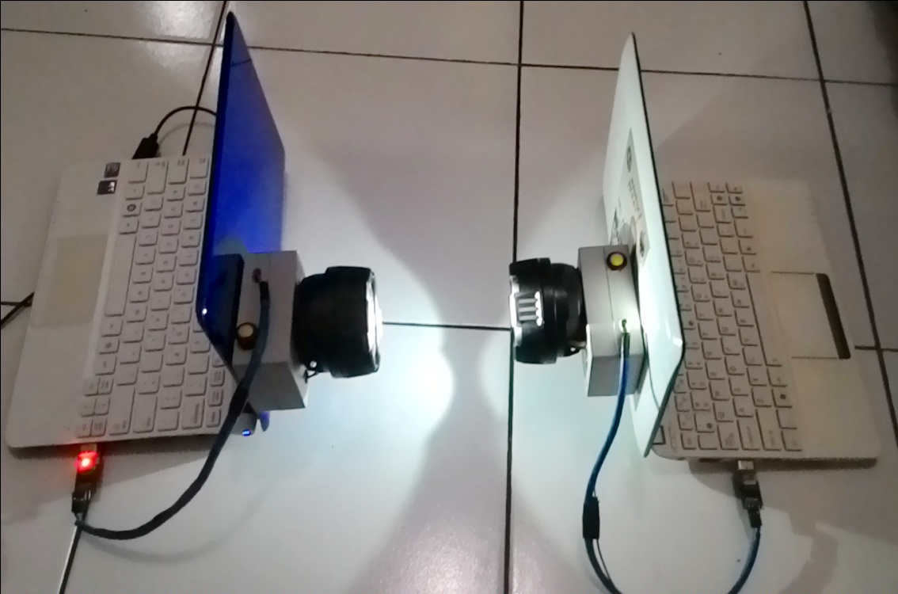
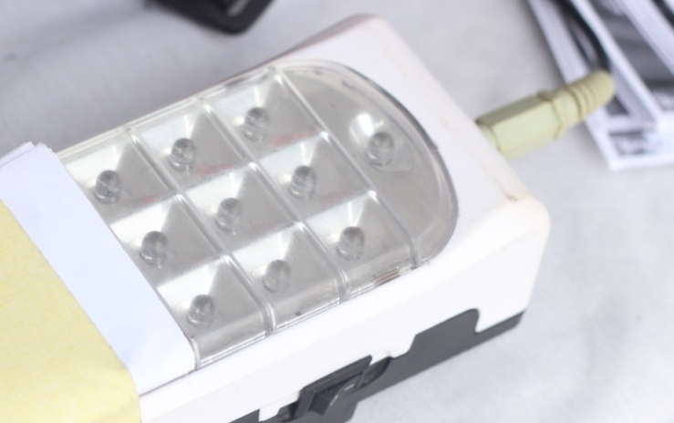
Produk VLC

Slide 38

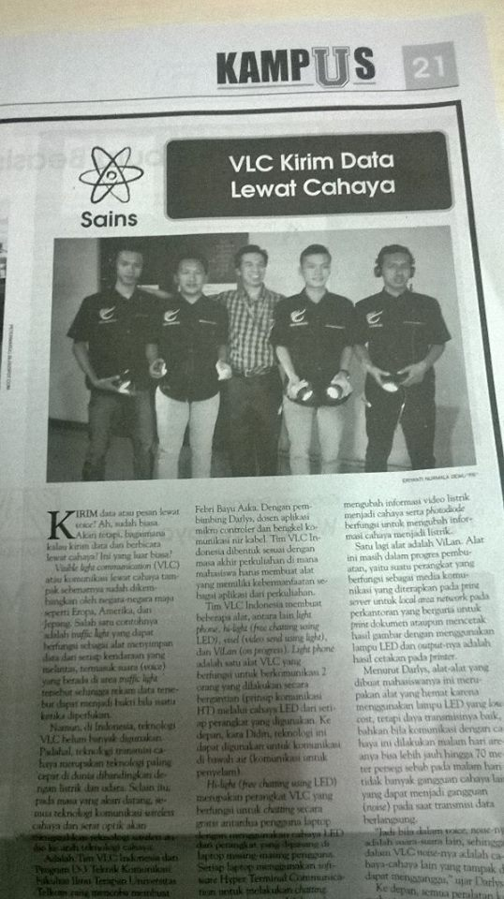
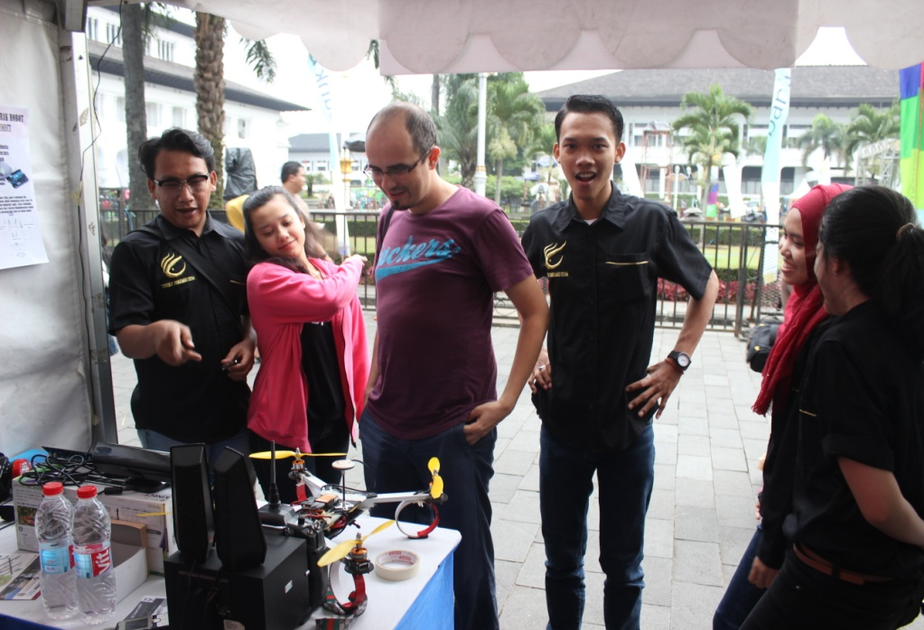
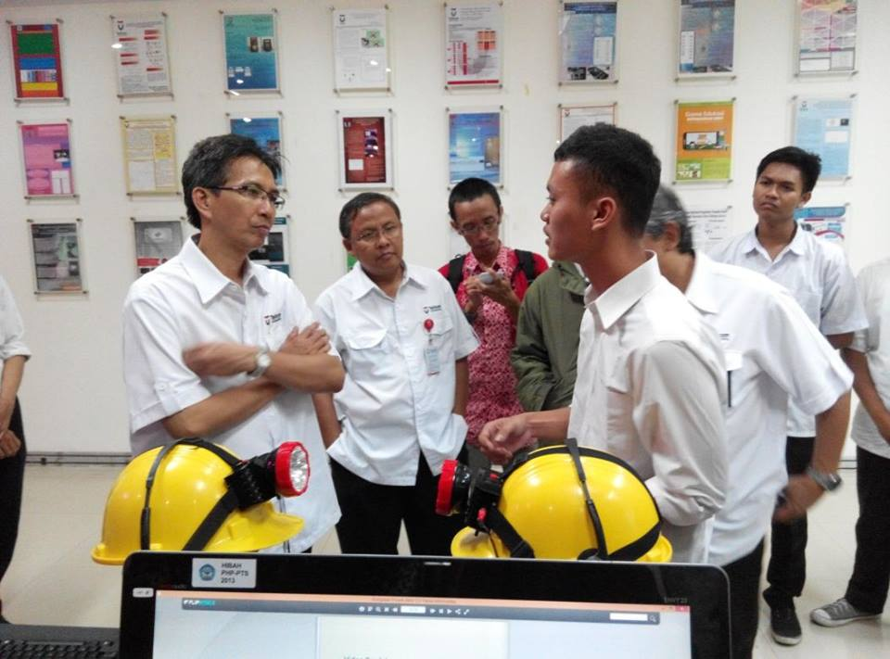


Tim RG VLC Indonesia

Slide 39
Referensi
Toshihiko Komine, “Visible Light Wireless Communications and Its Fundamental Study”, 2005
http://en.wikipedia.org/wiki/Visible_light_communication
Nikola Serafimovski, pureLiFi, IEEE 802.15-15-0107-01-007a-lifi-definition, 2015
http://www.ted.com/talks/harald_haas_wireless_data_from_every_light_bulb
Kang Tae Gyu,”Advanced Optical Wireless Communication System : Chapter 14 Visible Light Communication”, Cambridge University Press, 2012

Slide 40
Video Demo
LightMessage from pureVLC
AudioStreamLifi
LiFi Wireless Comm System

Slide 41
TERIMA KASIH ATAS PERHATIANNYA
Join us @
https://www.facebook.com/VLC4DoTETSoAS

